Slide 1
"If you cannot see it, you cannot operate it — logs, metrics, and traces as one story."
SUPPLEMENTARY · MODULE 9
Observability
Instrument Spring Boot for production: structured logs, Micrometer metrics, distributed tracing, and the alerts that turn a banking incident into a known playbook.
👁️
📊
📜
🔎
SPRING BOOT MICROSERVICES BOOTCAMP • DAY 4 • MODULE 9
Notes:
KEY TALKING POINTS
------------------
- Module scope
The module moves from monitoring versus observability, through the three pillars and a logging strategy, to metrics with Actuator and Micrometer, then tracing, context propagation, OpenTelemetry, health and readiness signals, alerting, and a troubleshooting workflow.
The hands-on checkpoint is Exercise 4.1: add health probes and correlation logging.
Tracing is a demonstration only; nobody stands up Jaeger in class.
- What the lab actually proves
Set expectations honestly.
Lab 4 proves liveness and readiness through /actuator/health/liveness and /actuator/health/readiness without a token, /actuator/info reporting version 1.0.0, /actuator/metrics returning a JSON list of meter names only with a JWT, and correlationId=lab4-demo appearing in both containers' logs.
Prometheus, Grafana, and a log stack are concepts today, not classroom installs.
REAL-WORLD EXAMPLES
-------------------
- In payments operations, a rising decline rate can come from a fraud rule change, a card network issue, or a slow database.
Teams with correlated logs, metrics, and traces narrow that down quickly.
Teams relying on a single CPU dashboard end up guessing and escalating.
USE-CASE SCENARIO
-----------------
Tell the room that Module 9 is about the question operations will ask the first time a teller says 'my transfer is stuck': which service, which request, and since when.
Everything in this module is a tool for answering that question quickly.

Slide 2
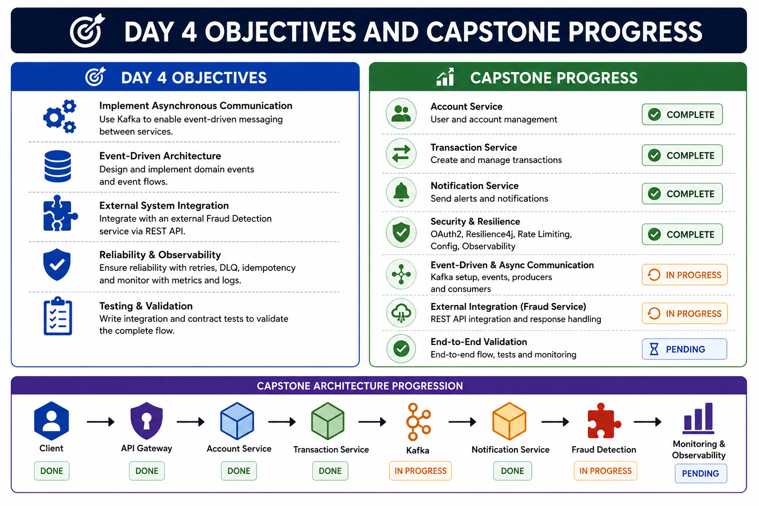
1
© 2026 by Innovation In Software Corporation
Notes:
KEY TALKING POINTS
------------------
- Day 4 Objectives panel
The image lists Kafka async communication, domain events, external Fraud Detection integration, reliability, and contract testing.
Most of that belongs to Days 2 and 3, or to no day at all.
State the real Day 4 objectives from the outline: structured logging, correlation IDs, Actuator and Micrometer, and a tracing demonstration; secure non-root Containerfiles; deploying to OpenShift with ConfigMaps, Secrets, probes, resources, and rollback; and a Tekton pipeline with scan, SBOM, and signing.
- Capstone Progress panel
The checklist shows Notification Service and a Fraud Service, which are not part of this capstone.
It shows Kafka still in progress and Observability already complete, and both are wrong.
The accurate state: Account Service was done on Day 1, and Transaction Service with Kafka events on Day 2.
JWT security, Resilience4j, tests, and log hygiene were done on Day 3.
Day 4 adds observability, containers, OpenShift, and CI/CD.
Risk Assessment Service is still pending for Day 5.
- Capstone Architecture Progression band
The bottom flow runs Client, API Gateway, Account, Transaction, Kafka, Notification, Fraud Detection, and Monitoring.
Our platform has no API Gateway, Notification, or Fraud Detection service.
The real chain is: a client calls Transaction Service; Transaction Service calls Account Service over REST with the JWT and X-Correlation-Id relayed; and it publishes to Kafka.
On Day 5, Risk Assessment Service calls an OpenShift AI model.
Use the band only to say that monitoring comes last in the chain, which is why it matters now.
REAL-WORLD EXAMPLES
-------------------
- Enterprise programme boards in banks track services through gates such as built, secured, observable, and deployable.
A status slide that marks observability complete before probes and correlation are verified is exactly how a service gets approved for production and then fails its first incident review.
- Platform teams commonly refuse to onboard a new microservice into a shared OpenShift environment until it exposes health endpoints and emits traceable logs.
That makes observability an entry criterion, not a nice-to-have at the end.
USE-CASE SCENARIO
-----------------
Walk the capstone state as a stand-up update.
'Account Service: built Day 1, secured Day 3.
Transaction Service: built Day 2 with RECEIVED to SUBMITTED over Kafka, and since Day 3 it returns a safe 503 when Account is down.
Risk Assessment Service: not started, Day 5.
Blocker for production: operations cannot yet probe readiness on the cluster, follow a correlationId across both containers, or roll back a release.
Today's Lab 4 clears that blocker.'

Slide 3
MONITORING VS. OBSERVABILITY
Monitoring answers known unknowns with dashboards and thresholds; observability explores unknown unknowns through logs, metrics, and traces.
📌
MONITORING: FOCUS ON KNOWN UNKNOWNS
🔍
OBSERVABILITY: FOCUS ON UNKNOWN UNKNOWNS
• Collect metrics -> alert on thresholds -> investigate, resolve, notify
• Best for detecting known issues, SLA tracking, capacity planning, compliance
• Collect logs, metrics, traces -> correlate & explore -> understand, decide, improve
• Best for exploring unknown issues, complex behavior, and root cause analysis
KEY TAKEAWAY Monitoring answers known unknowns with dashboards and thresholds; observability explores unknown unknowns through logs, metrics, and traces.
2
© 2026 by Innovation In Software Corporation
Notes:
KEY TALKING POINTS
------------------
- MONITORING: FOCUS ON KNOWN UNKNOWNS
Monitoring works when you can predict the failure ahead of time: disk nearly full, error rate above a threshold, latency over the SLA.
You decide the question in advance, build a dashboard or alert for it, and respond when it fires.
It is essential for SLA reporting, capacity planning, and the compliance evidence banks must produce.
Its limit is that it only answers questions someone thought to ask before the incident.
- OBSERVABILITY: FOCUS ON UNKNOWN UNKNOWNS
Observability is the ability to ask new questions of a running system without shipping new code.
That requires rich, correlated signals: logs with context, metrics with useful labels, and traces that show the request path.
When a failure nobody predicted happens, such as only one channel's transfers slowing down, you slice the data until the cause shows.
Monitoring is built on top of it; it does not replace monitoring.
REAL-WORLD EXAMPLES
-------------------
- Known unknown: a nightly statement-generation batch is alerted if it has not finished by a fixed time, because the team knows lateness is the risk.
That is classic monitoring, with a threshold, a dashboard, and a runbook.
- Unknown unknown: card authorisations slow down only for one merchant category after a partner certificate rotation.
No threshold was designed for that.
Engineers find it by filtering traces and logs by merchant category and endpoint, which is observability at work.
USE-CASE SCENARIO
-----------------
Picture the capstone after deployment.
A readiness alert on Transaction Service is monitoring: we knew a dead database would matter, so we probe for it.
Now suppose some transactions stay in RECEIVED and never reach SUBMITTED, while every health check is green.
No alert covers that case.
The team takes the correlationId from the teller's complaint, searches both services' logs, sees that the Account lookup succeeded, and then notices the event was never consumed.
That points them to Kafka, which is observability.

Slide 4
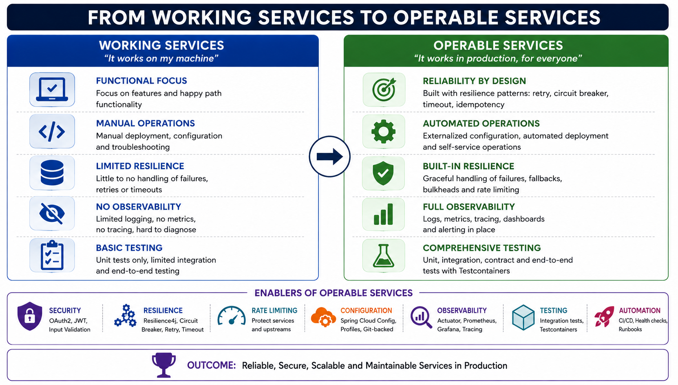
3
© 2026 by Innovation In Software Corporation
Notes:
KEY TALKING POINTS
------------------
- Working Services column
This describes a typical demo-grade service: happy path only, deployed and configured by hand, no timeouts or retries, logs that are hard to search, and unit tests only.
Point out that our capstone already left several of these rows behind on Day 3, when it gained JWT security, Resilience4j timeouts and a circuit breaker, the 503 safe fallback, and an integration test.
The row still true today is observability, plus manual operations.
- Operable Services column
Each row pairs with a row on the left.
Reliability and resilience come from patterns we already built.
Automated operations means externalized config and repeatable deployment, which Lab 4 delivers with ConfigMaps, Secrets, manifests, and a pipeline.
Full observability means logs, metrics, traces, and alerting.
Comprehensive testing is the target.
Testcontainers was awareness-level in this course, depending on the environment, so do not claim participants built a Testcontainers suite.
- Enablers of Operable Services
The seven icons map to course days.
Security and resilience were Day 3.
Rate limiting was covered conceptually.
Observability, automation, and health checks are today.
One correction: the Configuration enabler says Spring Cloud Config, Git-backed.
This course does not use a config server.
On OpenShift, configuration comes from ConfigMaps for URLs and Secrets for passwords and the JWT secret, injected as environment variables.
Prometheus and Grafana are named here as concepts; the lab does not install them.
- Outcome banner
The outcome is reliable, secure, scalable, and maintainable services in production.
Tie it to what a bank's production readiness review asks for: can operators check health without credentials, can a support engineer trace a customer's request, can the release be rolled back, and is the image scanned and signed?
Lab 4's success criteria are that checklist in miniature.
REAL-WORLD EXAMPLES
-------------------
- The Twelve-Factor App methodology, widely used for cloud-native services, captures several right-column rows: config in the environment, logs as event streams to stdout, and disposable processes.
The Lab 4 guide cites its separation of build from run.
- Many bank production readiness reviews require a documented rollback, health endpoints wired to the orchestrator, and a named on-call owner before a new service takes customer traffic.
A service can be functionally correct and still be blocked at that gate.
USE-CASE SCENARIO
-----------------
Score the capstone live.
For each row on the right, ask the room to vote: done, partial, or today.
Reliability by design is done, with the Resilience4j timeout and circuit breaker and the no-fake-ACTIVE fallback.
Built-in resilience is partial, since bulkheads and rate limiting were conceptual.
Full observability is partial: we have correlation logging and health, and today we add probes on the cluster and metrics behind a JWT.
Automated operations is today: Containerfiles, manifests, pipeline, rollback.
That turns an abstract slide into a gap analysis of their own code.

Slide 5
THE THREE PILLARS OF OBSERVABILITY · APPLICATION LOGGING STRATEGY
📌
LOGS: WHAT HAPPENED?
📊
METRICS & TRACES
• Timestamped records of discrete events; high cardinality, unstructured, stored as text
• Example: "Error connecting to database at 10:15:32 from service OrderService"
• Metrics: numeric measurements over time -- ideal for alerting and dashboards
• Traces: follow a request across services -- reveal latency, bottlenecks, dependencies
📌
WHAT TO LOG
✅
HOW TO LOG IT
• Operational events (startup, requests, business operations)
• Diagnostics (errors, validation failures), security & audit, performance
• Use structured (JSON) logging with consistent log levels
• Include correlation ID, user ID, service, and environment on every entry
• Never log sensitive data -- mask or exclude PII, credentials, tokens
KEY TAKEAWAY Logs give detailed context, metrics show trends and health, and traces reveal dependencies and root causes -- each pillar alone is incomplete. • Operational events, diagnostics, security/audit, and performance signals each need a place in a well-defined logging plan.
4
© 2026 by Innovation In Software Corporation
Notes:
TOPIC 1 OF 2: The Three Pillars of Observability
------------------------------------------
KEY TALKING POINTS
------------------
- LOGS: WHAT HAPPENED?
A log is an event record with a timestamp and detail: an error, a state change, a request.
Logs carry the richest context, such as the exception message or the account status that was rejected.
The bullet calls logs unstructured text, which describes how they often are, not how they should be; the next panel on this slide argues for structured JSON.
The example names an 'OrderService', but in our platform think of Transaction Service failing to reach its Postgres database.
- METRICS & TRACES
Metrics are cheap numbers aggregated over time, such as request count, error rate, p95 latency, or connection pool usage.
That makes them ideal for alerts and trend dashboards, but they lose per-request detail.
Traces follow one request across service hops as timed spans, showing where time went and which dependency failed.
Metrics tell you something is wrong, traces tell you where, and logs tell you why.
REAL-WORLD EXAMPLES
-------------------
- Payment gateway incident: a metric alert fires because authorisation error rate doubled.
A trace shows the time is spent in the call to the card-network adapter.
The adapter's logs show TLS handshake failures after a certificate change.
It takes all three pillars to reach the cause.
- Account opening funnel: metrics show completions dropping at the identity verification step.
Traces show the verification vendor call timing out.
Logs, with customer data masked, show which document type triggers the timeout.
USE-CASE SCENARIO
-----------------
In the capstone, a teller reports that a transfer was rejected.
The metric, HTTP 503 count on Transaction Service, shows a spike starting at 10:15.
A trace, in the demonstration setup, would show the Transaction Service span waiting on the Account Service client span until the Resilience4j timeout.
The Account Service log for that correlationId shows the database readiness failure.
Each signal answers a different question, and the correlationId is what joins them.
TOPIC 2 OF 2: Application Logging Strategy
------------------------------------------
KEY TALKING POINTS
------------------
- WHAT TO LOG
Operational events include startup with version and profile, inbound requests, and business milestones such as account activated or transaction submitted.
Diagnostics include errors and validation failures with enough context to reproduce them.
Security and audit covers authentication failures, access denials, and state changes on money-related records.
Performance covers slow calls and timeouts.
Every line should earn its storage cost and help someone at 2 a.m.
- HOW TO LOG IT
Structured JSON makes fields searchable without fragile regex, and consistent levels keep INFO quiet enough to read.
Put a correlation ID on every entry.
The lab does this through the CorrelationIdFilter, which puts the ID into MDC, and a logback pattern printing correlationId=.
Our lab uses a plain-text pattern rather than JSON, which is fine for a classroom.
Never log tokens, the Authorization header, passwords, or unmasked account or card numbers.
Lab 4 checks that directly.
REAL-WORLD EXAMPLES
-------------------
- Card platforms subject to PCI DSS must never write full card numbers to logs.
Teams mask to the last four digits at the logging layer so a developer's debug statement cannot leak a PAN into a log index that hundreds of engineers can read.
- Security teams investigating a suspicious login pattern rely on consistent audit events, with user, source, outcome, and timestamp.
If one service logs 'login failed' and another logs 'auth error 401' with different fields, correlating an attack across services becomes manual work.
USE-CASE SCENARIO
-----------------
During Lab 4, participants send a transaction with the header X-Correlation-Id: lab4-demo and then read docker logs for both containers.
They should find correlationId=lab4-demo in Transaction Service and in Account Service, because Transaction Service relays the header on its Account lookup.
They should not find the word Authorization or any JWT payload.
That one exercise tests the whole strategy: the right events, the right context, and no secrets.

Slide 6
STRUCTURED AND CENTRALIZED LOGGING
Fluent Bit/Filebeat ship logs from every microservice into Elasticsearch/Logstash/Kibana, where correlationId ties them all back together.
📌
CENTRALIZED LOGGING ARCHITECTURE
✅
BEST PRACTICES
• Microservices -> Log Shipper/Agent (Fluent Bit/Filebeat) -> Centralized Log Store (Elasticsearch)
• -> Users & Tools: search & analyze, dashboards, alerts, audit & compliance
• Log in structured JSON consistently; include correlationId/traceId in every log
• Centralize logs, set retention policies, and mask sensitive data
KEY TAKEAWAY Fluent Bit/Filebeat ship logs from every microservice into Elasticsearch/Logstash/Kibana, where correlationId ties them all back together.
5
© 2026 by Innovation In Software Corporation
Notes:
KEY TALKING POINTS
------------------
- CENTRALIZED LOGGING ARCHITECTURE
In containers, applications write to stdout and stderr, and an agent on each node collects those streams and ships them to a central store.
Nobody SSHes into pods, which may already be gone after a restart or rollout.
Elasticsearch with Kibana is one common stack.
On OpenShift, the platform's logging operator collects container output cluster-wide.
In class we read logs with docker logs and oc logs; no log stack is installed.
- BEST PRACTICES
Consistent structure means every service uses the same field names, so one query finds one request everywhere.
Including correlationId, or a traceId when tracing is on, is what joins lines across services.
Retention policy is both a cost and a compliance decision, because regulated records have minimum and maximum retention rules.
Masking must happen before the log leaves the process, since anything shipped to the central store is copied, indexed, and widely readable.
REAL-WORLD EXAMPLES
-------------------
- A retail bank's fraud operations team searches a central log index by correlation ID to rebuild everything that happened to one flagged card payment, from the channel app through authorisation and fraud scoring, without asking each owning team for their logs.
- Kubernetes and OpenShift pods are ephemeral: after a crash loop or rolling deployment, the old container's local logs are gone.
Teams that only read logs inside pods lose the evidence of the failure they are investigating, which is why node-level collection is standard.
USE-CASE SCENARIO
-----------------
After Lab 4's rollout of version 1.0.1 and the rollback with oc rollout undo, the pods that served 1.0.1 are terminated.
A support engineer then gets a complaint about a transaction submitted during that window.
With only oc logs on current pods, the evidence is gone.
With centralized logging, they search correlationId across both services for that time range and see the full story, including which version handled the request, because the service logged its version at startup.

Slide 7
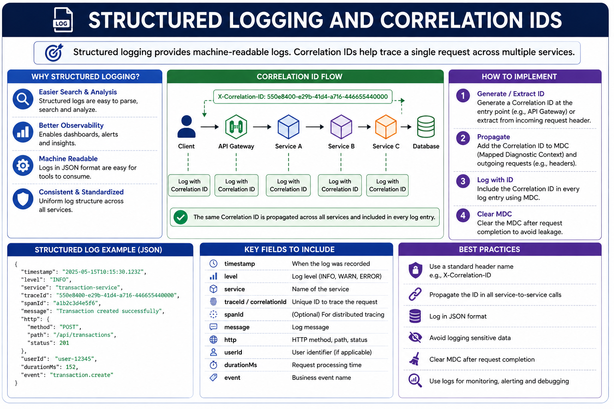
6
© 2026 by Innovation In Software Corporation
Notes:
KEY TALKING POINTS
------------------
- Why Structured Logging
The four reasons are easier search, better observability, machine readability, and consistency.
The practical point is that a tool can filter on a field such as correlationId equals lab4-demo exactly, instead of relying on text matching that breaks when someone changes a message.
Our lab uses a consistent plain-text pattern with correlationId= in a fixed place, which gives much of this benefit without JSON.
- Correlation ID Flow
The diagram uses a generic API Gateway and Services A, B, and C. Map it to our platform: the client calls Transaction Service, which relays the ID to Account Service.
In the lab the header is X-Correlation-Id.
HTTP header names are case-insensitive, so the image's X-Correlation-ID works the same, but participants should type the lab's spelling.
Beyond HTTP, Transaction Service stores the ID on the transaction and carries it in the Kafka event, and the consumer puts it back into MDC.
- How to Implement
These four steps match the lab's CorrelationIdFilter exactly.
It reads X-Correlation-Id, or generates a random UUID if it is missing.
It puts the value into MDC under the key correlationId and echoes it on the response header.
The logback pattern prints it on every line, and AccountClient adds it to the outbound call.
A finally block removes it from MDC, because servlet threads are pooled and a stale ID would otherwise leak into the next customer's request.
- Structured Log Example and Key Fields
The JSON shows timestamp, level, service, traceId, spanId, message, HTTP method, path and status, userId, duration, and event name.
Two cautions.
First, the example puts the correlation ID value in traceId; in real OpenTelemetry a trace ID is 32 hex characters generated by the tracer, and it may differ from a business correlation ID.
Second, userId should be an internal, non-sensitive identifier, never a customer account number.
- Best Practices
Standardize one header name across every team, propagate it on every service-to-service call including messaging, log in a consistent structure, avoid sensitive data, clear MDC after each request, and use logs for alerting and debugging as well.
In banking, agree the header name at platform level.
If one team uses X-Request-Id and another X-Correlation-Id, the chain silently breaks at their boundary.
REAL-WORLD EXAMPLES
-------------------
- Banks commonly return a reference or correlation ID in an error response, and teach contact-centre staff to ask the customer for it.
That lets second-line support jump straight to the exact request in the logs instead of searching by time and account.
- A thread-pool MDC leak is a well-known Java pitfall.
If the ID is not cleared, the next request handled on that thread logs the previous customer's correlation ID, so investigators can end up attributing actions to the wrong session.
USE-CASE SCENARIO
-----------------
Run it as a mini-demo before Exercise 4.1.
Send POST /api/v1/transactions to port 8082 with X-Correlation-Id: lab4-demo and the ops token.
Show the response header echoing lab4-demo.
Run docker logs on md287-lab4-transaction and md287-lab4-account and find correlationId=lab4-demo in both.
Then send a request with no header and show that a UUID was generated and still appears in both containers.
Finally, ask what correlationId= the Kafka consumer lines show.
They show the same ID, because it travelled in the event.

Slide 8
METRICS AND TIME-SERIES MONITORING · PROMETHEUS METRICS MODEL · SPRING BOOT ACTUATOR AND MICROMETER
📌
HOW IT WORKS
✅
KEY METRIC CATEGORIES
📌
CORE CONCEPTS
• Your Application (Spring Boot) -> Prometheus/Micrometer collection -> Time-Series Storage
• -> Grafana visualization -> Dashboards & Alerts
• Application performance, resource utilization, business metrics
• Service health, and SLOs and limits (latency/error thresholds)
• Time series: a sequence of timestamped values identified by metric name and labels
• Labels give dimensional context; samples are the actual recorded values
• All time series stored in the Prometheus TSDB
✅
METRIC TYPES
📌
WHAT THEY PROVIDE
✅
BEST PRACTICES
• Counter (monotonically increasing), Gauge (up or down), Histogram/Summary (distributions)
• Actuator: production-ready endpoints (health, info, metrics, loggers, threaddump)
• Micrometer: a metrics facade that instruments code and publishes to Prometheus, Grafana, Datadog, and more
• Expose only the endpoints you need; secure Actuator endpoints
• Use meaningful metric names and tags; monitor SLOs with actionable dashboards
KEY TAKEAWAY Spring Boot instruments with Micrometer, Prometheus stores the time series, and Grafana turns it into dashboards and alerts. • http_requests_total{method="GET", status="200", service="order"} 1027 shows exactly how metric name, labels, and sample value combine. • /actuator/health, /actuator/metrics, and /actuator/prometheus turn a Spring Boot service into an observable system with two dependencies.
7
© 2026 by Innovation In Software Corporation
Notes:
TOPIC 1 OF 3: Metrics and Time-Series Monitoring
------------------------------------------
KEY TALKING POINTS
------------------
- HOW IT WORKS
Micrometer, inside the application, records meters.
Prometheus does not receive pushes from Spring Boot.
It scrapes, or pulls, an HTTP endpoint on an interval, stores the samples in its time-series database, and evaluates alert rules.
Grafana then queries Prometheus to draw dashboards.
In the lab we stop at the application end: /actuator/metrics returns JSON meter names and values behind a JWT.
No Prometheus or Grafana is installed in class.
- KEY METRIC CATEGORIES
Application performance covers request rate, error rate, and latency percentiles.
Resource utilization covers JVM heap, CPU, threads, and database connection pool usage.
Business metrics count outcomes such as transactions submitted or rejected.
Service health reflects up or down and readiness.
SLOs and limits turn these into commitments, such as 99 percent of transaction submissions answering within an agreed latency.
Good dashboards combine technical and business categories side by side.
REAL-WORLD EXAMPLES
-------------------
- A card authorisation platform typically tracks approval rate as a business metric next to p99 latency.
A sudden drop in approvals with normal latency points to a rules or issuer problem, not an infrastructure problem, which changes who gets paged.
- Online banking teams watch database connection pool saturation during salary-day login peaks.
A pool running at its maximum explains rising latency long before CPU looks unusual, and that is a resource metric doing its job.
USE-CASE SCENARIO
-----------------
Imagine Transaction Service in production on OpenShift.
A Prometheus instance scrapes every pod.
Grafana shows the request rate on POST /api/v1/transactions, the count of 503 responses, the Resilience4j circuit breaker state, and a business counter of submitted transactions.
At 10:15 the 503 panel climbs while submitted transactions flatten, and the circuit breaker panel shows OPEN.
Before anyone opens a log, the team knows Account Service is the dependency in trouble.
TOPIC 2 OF 3: Prometheus Metrics Model
--------------------------------------
KEY TALKING POINTS
------------------
- CORE CONCEPTS
Every unique combination of metric name and label values is its own time series.
So http_requests_total with status 200 and the same metric with status 503 are two series.
Labels let you slice, for example error rate by URI or by service.
Each additional label value multiplies the series count, which is why unbounded labels such as an account number can overload Prometheus.
The takeaway example uses service equals order; in our platform picture account-service or transaction-service.
- METRIC TYPES
A counter only goes up, and resets on restart, so you graph its rate rather than its raw value.
Total requests and total rejections are counters.
A gauge moves both ways: active connections, queue depth, heap used.
Histograms and summaries capture distributions so you can report p95 latency.
Spring Boot's Micrometer HTTP timer is http.server.requests; through a Prometheus registry it appears as http_server_requests_seconds with count, sum, and bucket series, not http_requests_total.
REAL-WORLD EXAMPLES
-------------------
- A payments team graphs the per-second rate of a payments-rejected counter labelled by reason code.
A spike in one reason code, such as insufficient funds, reads as normal customer behaviour, while a spike in a technical reason code triggers an incident.
- Teams have taken down their own Prometheus servers by adding a label holding a customer or session identifier, which creates millions of series.
Cardinality reviews of new metrics are now a routine platform-team practice.
USE-CASE SCENARIO
-----------------
Ask participants to design one metric for Transaction Service: transactions created, as a counter labelled by outcome with values RECEIVED, REJECTED, and UNAVAILABLE.
Outcome has a handful of values, so cardinality stays safe.
Then ask a volunteer to propose adding accountId as a label, and walk through why that creates one series per account and breaks the metrics store.
Account-level questions belong in logs and traces, not metric labels.
TOPIC 3 OF 3: Spring Boot Actuator and Micrometer
------------------------------------------
KEY TALKING POINTS
------------------
- WHAT THEY PROVIDE
spring-boot-starter-actuator adds the endpoints and pulls in Micrometer, which instruments HTTP requests, JVM, and datasource pools automatically.
Important distinction: /actuator/metrics returns JSON, a list of names or one meter's measurements.
The Prometheus text format comes only from /actuator/prometheus, and only when micrometer-registry-prometheus is added, which is the 'second dependency' in the subtitle.
Our lab services include Actuator but not that registry, so /actuator/prometheus does not exist in class.
- BEST PRACTICES
Lab 3 exposed only health and info.
Lab 4's Compose file adds metrics, and the security rules keep it behind a JWT while health stays public for probes.
Never expose env, heapdump, or threaddump publicly.
They can reveal configuration, memory contents, and internals.
Loggers can change log levels at runtime, which is an operational control, not a public API.
Name custom meters clearly, tag with low-cardinality values, and build dashboards that answer SLO questions.
REAL-WORLD EXAMPLES
-------------------
- Security researchers have repeatedly reported internet-exposed Spring Boot Actuator endpoints, especially env and heapdump, leaking credentials and session data.
Many enterprise security baselines now require an explicit allow-list of exposed Actuator endpoints.
- Banks using OpenShift commonly let the platform probe /actuator/health/liveness and /actuator/health/readiness without authentication, while metrics scraping uses a separate port, network policy, or credentials so business data in meters is not public.
USE-CASE SCENARIO
-----------------
Lab 4 Step 4 tests this split directly.
curl.exe to http://localhost:8081/actuator/health/liveness with no token returns 200, because operators must probe without credentials.
curl.exe to /actuator/metrics with no token is refused.
With the teller token it returns a JSON list of meter names such as http.server.requests and jvm.memory.used.
/actuator/info returns version 1.0.0, the same value Step 7 bumps to 1.0.1 and then rolls back.

Slide 9
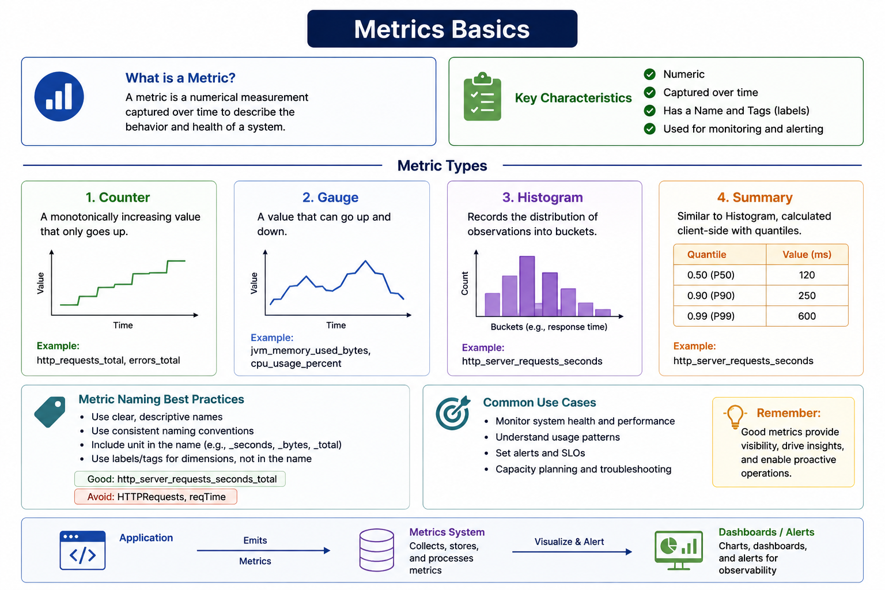
8
© 2026 by Innovation In Software Corporation
Notes:
KEY TALKING POINTS
------------------
- What is a Metric and Key Characteristics
A metric is a cheap, numeric summary sampled over time.
That makes it ideal for dashboards and alerts, but it cannot tell the story of a single request the way a log line or a trace can.
The labels part matters: the same http.server.requests timer carries tags for method, URI, and status, so one metric answers many questions.
In Lab 4, /actuator/metrics lists these meter names, and it requires a teller JWT.
- Metric Types
Counters answer how many, and alerts usually use their rate, such as failed transactions per minute.
Gauges answer how much right now, such as heap used or the size of a connection pool.
Histograms and summaries answer how spread out, which is where percentiles like p99 latency come from.
The summary's quantile values on the diagram are illustrative, not measurements.
The practical rule: prefer histograms when you need to combine latency across several replicas, because pre-computed quantiles from each pod cannot be merged correctly.
- Metric Naming Best Practices
Consistent, unit-bearing names make dashboards readable across teams.
Labels, not name variants, should carry dimensions such as service or status.
Treat the diagram's Good example cautiously.
In Prometheus conventions, _total is reserved for counters, and a Micrometer timer is exported as http_server_requests_seconds_count, _sum, and optionally _bucket.
The Avoid examples are right: mixed case and abbreviations like reqTime make names hard to find and compare.
- Common Use Cases and metrics pipeline
Metrics support health monitoring, usage patterns, SLOs, alerting, and capacity planning.
The bottom strip shows the pipeline.
Micrometer inside Spring Boot records meters, Actuator exposes them, a metrics system such as Prometheus or OpenShift's built-in monitoring stores them, and dashboards and alert rules query them.
In class we stop at the Actuator endpoint.
Wiring a full Prometheus scrape of the capstone is not part of Lab 4.
REAL-WORLD EXAMPLES
-------------------
- Card authorisation latency: a card platform tracks authorisation response time as a histogram, labelled by card network and response code.
The team alerts when p99 latency across all pods stays above its target, something they could not compute correctly from per-pod averages.
- Branch cash management: a gauge tracks the size of the unprocessed cash-order queue, and a counter tracks orders completed.
Together they show whether the backlog is growing faster than the team clears it, which feeds staffing and capacity decisions.
USE-CASE SCENARIO
-----------------
After Lab 4 Step 4, a participant calls /actuator/metrics on Account Service with a teller token and sees meter names such as http.server.requests and jvm.memory.used.
The instructor asks which type each is.
jvm.memory.used is a gauge.
http.server.requests is a timer, which carries a count, a total time, and a maximum.
The team then proposes a business counter for accounts created and a gauge for accounts awaiting activation.
That shows how PENDING accounts that never become ACTIVE could surface on a dashboard long before a customer complains.

Slide 10
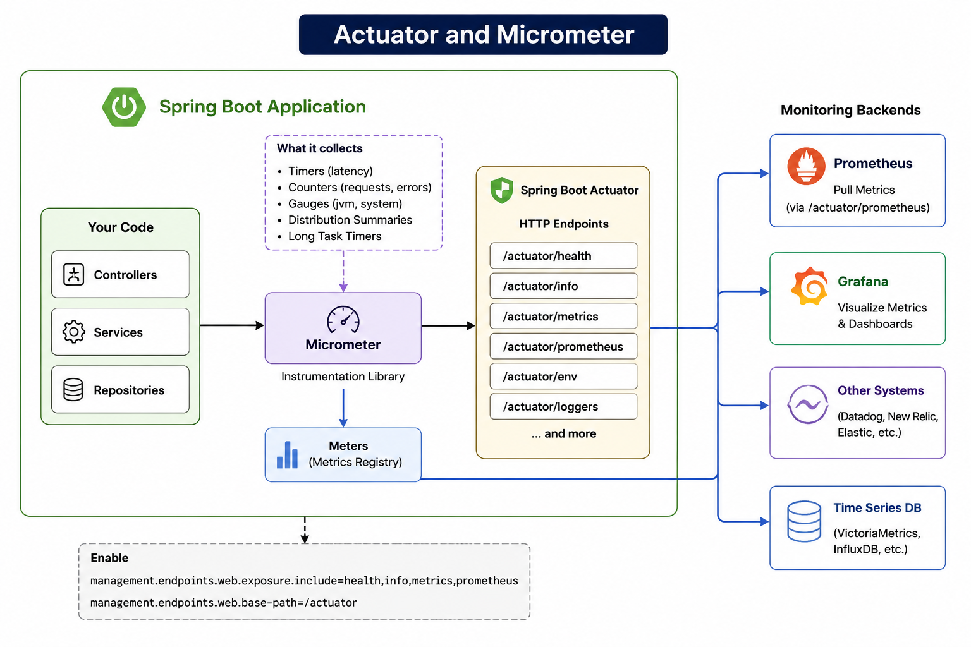
9
© 2026 by Innovation In Software Corporation
Notes:
KEY TALKING POINTS
------------------
- Your Code and Micrometer
Controllers, services, and repositories are instrumented two ways.
Automatically, Spring Boot times every HTTP request and watches JVM and connection pools.
Explicitly, you inject a MeterRegistry and create a counter or timer for business events.
The dashed What It Collects box lists the meter types.
Micrometer is a facade, like SLF4J for logging: you code against it once and choose the backend with a dependency.
- Meters (Metrics Registry)
The registry holds every meter with its name and tags.
Actuator reads from it to answer /actuator/metrics.
A backend-specific registry, such as the Prometheus one, formats the same meters for its system.
Some registries, such as Datadog's, push on a schedule, while Prometheus is pulled.
That explains why the diagram has arrows leaving from the registry as well as from the endpoints.
- Spring Boot Actuator HTTP Endpoints
Health, info, metrics, prometheus, env, and loggers are shown.
In our lab only health and info are exposed in Lab 3, and metrics is added in Lab 4 behind a JWT.
/actuator/prometheus appears only when micrometer-registry-prometheus is on the classpath, which the lab services do not include.
Point out /actuator/env as an endpoint a bank would not expose, because it can reveal configuration.
- Monitoring Backends
Prometheus pulls from /actuator/prometheus, and that label is correct.
The arrow to Grafana is a simplification: Grafana does not read Actuator.
It queries a data source such as Prometheus.
Other Systems such as Datadog or New Relic, and time-series databases, receive data through their own Micrometer registries.
On OpenShift, the built-in monitoring stack is Prometheus-based and can scrape application pods when user workload monitoring is enabled.
- Enable configuration
The Enable box shows management.endpoints.web.exposure.include=health,info,metrics,prometheus and the base path /actuator, which is already Spring Boot's default.
Contrast with the lab.
Lab 3 includes health,info, and Lab 4 Compose sets MANAGEMENT_ENDPOINTS_WEB_EXPOSURE_INCLUDE to health,info,metrics.
The property also enables health probe groups with management.endpoint.health.probes.enabled: true.
Adding prometheus to the list without the registry dependency does nothing.
REAL-WORLD EXAMPLES
-------------------
- Organizations moving between monitoring vendors, for example from one SaaS observability tool to a self-hosted Prometheus, can keep application instrumentation code unchanged when it is written against Micrometer, and swap only the registry dependency and configuration.
- OpenShift includes a Prometheus-based monitoring stack.
With user workload monitoring enabled, application teams define a ServiceMonitor to have their pods' metrics endpoint scraped, which is a common path for Spring Boot services on the platform.
USE-CASE SCENARIO
-----------------
Suppose the risk platform team later wants a Grafana panel of Account Service lookup latency from Transaction Service.
The steps follow the diagram left to right.
The AccountClient call is already timed by Micrometer's HTTP client instrumentation, or with an explicit Timer.
Add micrometer-registry-prometheus.
Add prometheus to the exposure list and decide how the scrape is secured.
Have the cluster's Prometheus scrape the pod.
Point Grafana at Prometheus.
None of those steps changes business logic, which is the value of the facade.

Slide 11
CUSTOM BUSINESS AND TECHNICAL METRICS · GRAFANA DASHBOARD DESIGN · DISTRIBUTED TRACING
📌
TYPES OF CUSTOM METRICS
✅
NAMING & TAGGING GUIDELINES
📌
DESIGN PRINCIPLES
• Counter: a monotonically increasing value (e.g., orders.placed)
• Timer: records duration and percentiles (e.g., payment.processing.time)
• Gauge and Distribution Summary for point-in-time values and value distributions
• Use dot-separated, lowercase, consistent metric names
• Good tags: service, region, status, channel; avoid high-cardinality tags like user.id
• Know your audience and focus on the goals/questions the dashboard should answer
• Favor clarity over complexity; use time ranges that fit the use case
• Highlight issues and make insights actionable
✅
LAYOUT TIPS
📌
WHY DISTRIBUTED TRACING
✅
TRACE + METRICS + LOGS = OBSERVABILITY
• KPIs at the top, trends in the middle (time series), details at the bottom (tables)
• Use variables for environment/service/region filters; group panels into rows
• End-to-end visibility of a request's full path across services
• Faster root cause analysis; visualizes service dependencies
• Reduces MTTR and validates SLOs and user experience
• Traces (structure) + Metrics (quantitative) + Logs (context) = actionable insight
• Propagate trace-id/span-id across every service and messaging boundary
KEY TAKEAWAY A Counter for orders.placed and a Timer for payment.processing.time turn business outcomes and technical health into first-class metrics. • Request rate, error rate, p95 latency, availability, and saturation as top-row KPIs give an instant read on service health before anyone drills in. • A request flowing through API Gateway, Order, Payment, and Inventory services becomes one connected trace, with each hop as a timed span.
10
© 2026 by Innovation In Software Corporation
Notes:
TOPIC 1 OF 3: Custom Business and Technical Metrics
------------------------------------------
KEY TALKING POINTS
------------------
- TYPES OF CUSTOM METRICS
The examples are e-commerce.
Translate them for our platform: a counter such as transactions.submitted, and a timer such as account.lookup.duration around the Account Service call.
A gauge fits a point-in-time value such as transactions waiting in RECEIVED, and a distribution summary fits values like transaction amounts in bands.
In Spring Boot you register these through the injected MeterRegistry.
Timers can publish percentiles or histograms for p95 and p99.
- NAMING & TAGGING GUIDELINES
Micrometer names use dots, and each registry converts them: the Prometheus registry turns transactions.submitted into transactions_submitted_total.
Tags should have a small, known set of values, such as service, status, channel (teller, mobile, online), or outcome.
Never tag with user IDs, account numbers, or correlation IDs.
Cardinality explodes, and in banking such tags can also leak customer identifiers into a system with weaker access controls than the core ledger.
REAL-WORLD EXAMPLES
-------------------
- Digital banking teams often chart logins and payments per channel, tagging a counter with a channel value such as mobile or web.
When a mobile app release breaks payments, the mobile series drops while web stays flat, which isolates the cause within minutes.
- Loan origination teams track applications submitted, auto-decisioned, and referred to manual underwriting as counters with a product tag.
A rising referral share is a business signal that a scoring rule or model change needs review.
USE-CASE SCENARIO
-----------------
Design Transaction Service's business metrics with the room.
Use a counter transactions.created tagged by result: RECEIVED, REJECTED_ACCOUNT_NOT_ACTIVE, or UNAVAILABLE for the 503 fallback.
Add a timer account.lookup.duration tagged by outcome.
On Day 5, Risk Assessment Service could add a counter tagged by decision: approve, review, or decline.
Then ask what would happen if someone tagged transactions.created with accountId.
That is one series per account, and customer identifiers in a metrics store.
TOPIC 2 OF 3: Grafana Dashboard Design
--------------------------------------
KEY TALKING POINTS
------------------
- DESIGN PRINCIPLES
A dashboard is an answer to a question.
The on-call engineer asks whether the service is healthy right now.
A product owner asks whether transaction volume is normal for a Monday.
Mixing both on one screen serves neither.
Clarity means few panels, consistent units, and thresholds drawn on the graph.
Actionable means that when a panel goes red, the viewer knows the next step, ideally with a link to the runbook or the relevant logs query.
- LAYOUT TIPS
Top-row KPIs give the five-second read: rate, errors, p95 latency, availability, saturation.
The middle rows show trends over time so you can see when something began.
The bottom holds tables for drill-down, such as top failing endpoints.
Variables let one dashboard serve every environment and service through dropdowns, instead of copying a dashboard per project.
Rows keep related panels, like JVM and database pool, collapsible.
REAL-WORLD EXAMPLES
-------------------
- Google's Site Reliability Engineering book describes the four golden signals of latency, traffic, errors, and saturation.
Many bank service dashboards use them as the top row because they apply to any request-serving service, including authorisation and payments APIs.
- Operations centres at large banks often run a summary wall screen per business service, such as cards or payments, with drill-down links into per-microservice dashboards.
That split keeps the wall readable while engineers still get detail.
USE-CASE SCENARIO
-----------------
Sketch a Transaction Risk Platform dashboard on the whiteboard.
Top row: transaction submission rate, 503 rate, Account lookup p95, circuit breaker state, and pod readiness count.
Middle: trends of the same over the last six hours.
Bottom: a table of error responses by endpoint.
Variables: project, such as md287-<username>, and service.
Ask which panel the on-call engineer checks first when a teller reports failures.
It should be in the top-left, where eyes land.
TOPIC 3 OF 3: Distributed Tracing
---------------------------------
KEY TALKING POINTS
------------------
- WHY DISTRIBUTED TRACING
In a monolith a stack trace shows the whole call path.
In microservices the path crosses processes, so no single stack trace exists.
A trace rebuilds that path as timed spans, showing that a two-second transaction spent most of its time waiting on Account Service.
That shortens mean time to recovery because teams stop debating whose service is slow.
The takeaway's Gateway, Order, Payment, and Inventory chain is e-commerce; ours is Transaction Service calling Account Service and publishing to Kafka.
- TRACE + METRICS + LOGS = OBSERVABILITY
Traces give the shape of a request, metrics give the numbers across all requests, and logs give the detail of one event.
They become one system when they share identifiers: a log line carrying the traceId, and an exemplar on a latency metric linking to a sample trace.
Propagation must cover HTTP and messaging.
A trace that stops at the Kafka publish hides the consumer half of the transaction flow.
In our course tracing is a demonstration; the lab's cross-service handle is the correlationId.
REAL-WORLD EXAMPLES
-------------------
- Uber built and open-sourced Jaeger to trace requests across its large microservice estate, and Jaeger is now a Cloud Native Computing Foundation project.
It is one of the backends named on the next slides.
- In a bank's payment initiation flow, a single customer payment can touch channel API, sanctions screening, fraud scoring, and the ledger.
When customers complain of slow payments, a trace shows at a glance whether screening or the ledger holds the time.
USE-CASE SCENARIO
-----------------
Describe the demonstration trace.
A teller submits a transaction.
Span 1 is Transaction Service handling POST /api/v1/transactions.
Span 2, a child, is the HTTP client call to Account Service.
Span 3 is Account Service handling the lookup, including its database query.
Span 4 is publishing the event to Kafka, and span 5 is the consumer moving the transaction to SUBMITTED.
If span 2 shows 2 seconds and span 3 only 20 milliseconds, the delay is network or connection-pool waiting, not Account Service's code.

Slide 12
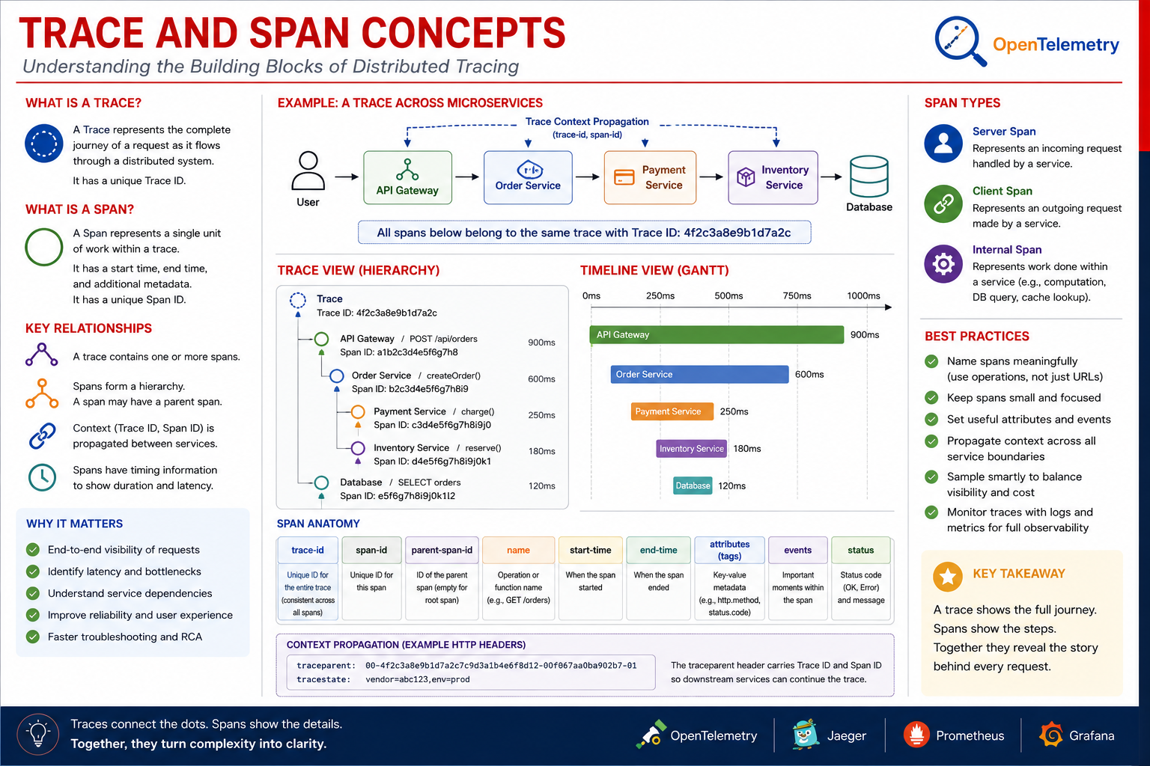
11
© 2026 by Innovation In Software Corporation
Notes:
KEY TALKING POINTS
------------------
- TRACE VS. SPAN
A trace is the whole journey of one request and has one trace ID.
A span is one timed unit of work inside it, such as handling the HTTP request, calling another service, or running a query.
Each span has its own span ID, start and end time, and attributes, plus a parent span ID linking it to the step that caused it.
The root span has no parent.
The tree built from those parent links is what tracing tools draw as the waterfall.
- SPAN TYPES
A server span records a service handling an incoming request, such as Account Service receiving the lookup.
A client span records the outgoing call, such as Transaction Service's AccountClient.
Pairing them shows network and queueing time between the two.
Internal spans record local work such as a validation step.
OpenTelemetry also defines producer and consumer span kinds for messaging, which the slide omits.
They are the ones our Kafka publish and consume would use.
REAL-WORLD EXAMPLES
-------------------
- Spring Boot 3 replaced Spring Cloud Sleuth with Micrometer Tracing.
With the OpenTelemetry bridge on the classpath, Spring MVC server requests and RestClient or RestTemplate calls built from Spring's auto-configured builders produce server and client spans automatically, and the trace and span IDs can be added to log lines.
- In card fraud screening, a waterfall view commonly shows a rules-engine span followed by a model-scoring span.
When authorisation latency rises, engineers compare the two bars directly instead of checking each team's dashboards separately.
USE-CASE SCENARIO
-----------------
Map the waterfall onto our platform.
The root server span is Transaction Service handling POST /api/v1/transactions, 300ms.
Its child is a client span calling Account Service, 250ms, and under that is Account Service's server span, 40ms, with an internal database query span, 15ms.
The 210ms gap between the client span and Account's server span points to connection waiting, not slow code.
A producer span for the Kafka publish follows, and later a consumer span, in the same trace, moves the status to SUBMITTED.

Slide 13
CONTEXT PROPAGATION
W3C Trace Context headers (traceparent, tracestate) carry the trace-id and span-id across HTTP, messaging, and gRPC boundaries alike.
📌
HOW CONTEXT FLOWS
✅
THE PROPAGATION LIFECYCLE
• HTTP/REST: W3C Trace Context headers (traceparent, tracestate)
• Messaging (Kafka in Lab 2): correlation id injected into message headers
• gRPC and async events: context carried in metadata or event headers
1. Create: the first service starts a trace and generates the trace and span identifiers
2. Inject: those identifiers are written into outbound headers before the call leaves
3. Transmit: the headers travel with the request over HTTP or alongside the message
4. Extract: the receiving service reads the identifiers back out of the incoming request
5. Continue: it opens a new span linked to the same trace, keeping the path connected end to end
KEY TAKEAWAY W3C Trace Context headers (traceparent, tracestate) carry the trace-id and span-id across HTTP, messaging, and gRPC boundaries alike.
12
© 2026 by Innovation In Software Corporation
Notes:
KEY TALKING POINTS
------------------
- HOW CONTEXT FLOWS
The W3C traceparent header has four parts: version, a 32-hex-character trace ID, a 16-hex-character parent span ID, and flags such as sampled.
tracestate carries vendor-specific extras.
Kafka records support headers, and tracing instrumentation injects traceparent there.
One correction to our own labs: the capstone's correlation ID travels in HTTP as X-Correlation-Id.
On Kafka it travels inside the event payload as a correlationId field, not as a message header; the consumer puts it back into MDC.
- THE PROPAGATION LIFECYCLE
Create happens at the edge when no context arrives.
Inject writes identifiers into outgoing headers.
Transmit is the network or broker carrying them.
Extract reads them on the receiving side.
Continue starts a child span under the same trace.
Our CorrelationIdFilter and AccountClient do the same manually: they extract or create the ID, keep it in MDC, and inject it into the outbound Account call.
Breakages usually come from hand-built clients, thread hand-offs, and async executors that drop the context.
REAL-WORLD EXAMPLES
-------------------
- Cloud providers and observability vendors adopted the W3C Trace Context recommendation so that a trace can cross from one vendor's instrumented service to another's without custom header mapping.
That matters when a bank's services call a managed gateway or partner API.
- A common failure in event-driven banking systems is a trace that ends at the Kafka publish because the producer was not instrumented.
The payment appears to finish instantly, while the real processing time sits in an unconnected consumer trace.
USE-CASE SCENARIO
-----------------
Walk a transaction through the lifecycle using the lab's correlation ID.
A teller client sends no header, so Transaction Service's filter creates a UUID.
AccountClient injects X-Correlation-Id on the call to port 8081, and Account Service's filter extracts it and logs with it.
Transaction Service saves the ID on the transaction record, writes it into the event it publishes, and the consumer restores it to MDC before moving the status to SUBMITTED.
Now ask: 'What breaks if AccountClient forgets the header?' Account Service generates a new UUID, and the chain splits in two.

Slide 14
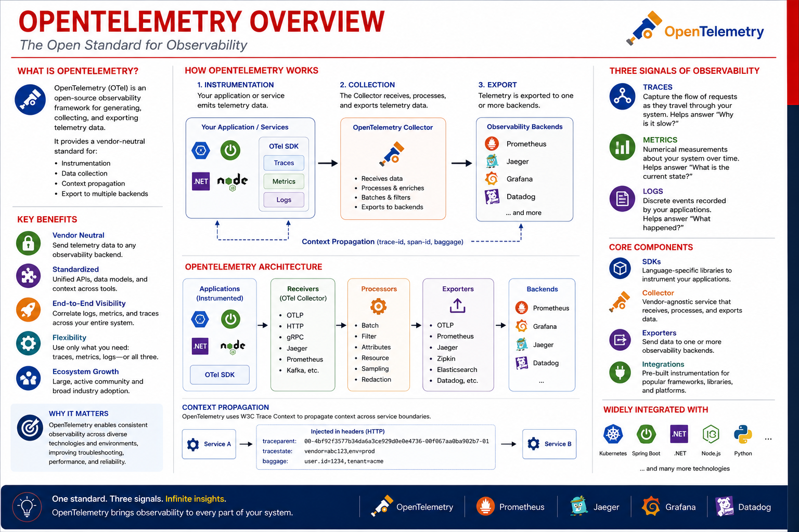
13
© 2026 by Innovation In Software Corporation
Notes:
KEY TALKING POINTS
------------------
- HOW OPENTELEMETRY WORKS
Instrumentation happens in the application through the OTel SDK, an agent, or Spring Boot's Micrometer Tracing bridge, and it produces traces, metrics, and logs.
The Collector is a separate service that receives telemetry over OTLP and other protocols, processes it by batching, filtering, sampling, and redacting, and exports it.
The Collector is optional, since an SDK can export directly, but it keeps credentials and routing out of application code.
Export sends the same data to one or several backends.
- KEY BENEFITS
Vendor neutrality means instrumentation code does not change when a bank switches or adds a backend.
Standard APIs and semantic conventions make an HTTP span look the same whether it came from Java, .NET, or Node.js.
That matters in banks with mixed estates.
Signals are adoptable one at a time; many teams start with traces and keep existing metrics and logging.
The Collector's redaction processor also gives a central place to strip sensitive attributes before data leaves the cluster.
REAL-WORLD EXAMPLES
-------------------
- OpenTelemetry is a Cloud Native Computing Foundation project formed by merging the OpenTracing and OpenCensus projects.
Major observability vendors accept OTLP data, which is why enterprises treat it as the default instrumentation choice for new services.
- Red Hat ships a Red Hat build of OpenTelemetry for OpenShift, so platform teams can run a managed Collector in the cluster and route application traces to their chosen backend without each application team configuring exporters.
USE-CASE SCENARIO
-----------------
Describe a future state for the risk platform.
Account, Transaction, and, from Day 5, Risk Assessment Service each add Micrometer Tracing with the OpenTelemetry bridge and export OTLP to a Collector in the OpenShift project.
The Collector batches spans, drops any attribute named like an account number with a redaction processor, samples routine traffic while keeping all error traces, and exports to the bank's tracing backend.
If the bank later changes vendors, only the Collector's exporter configuration changes.
None of the three services is rebuilt.

Slide 15
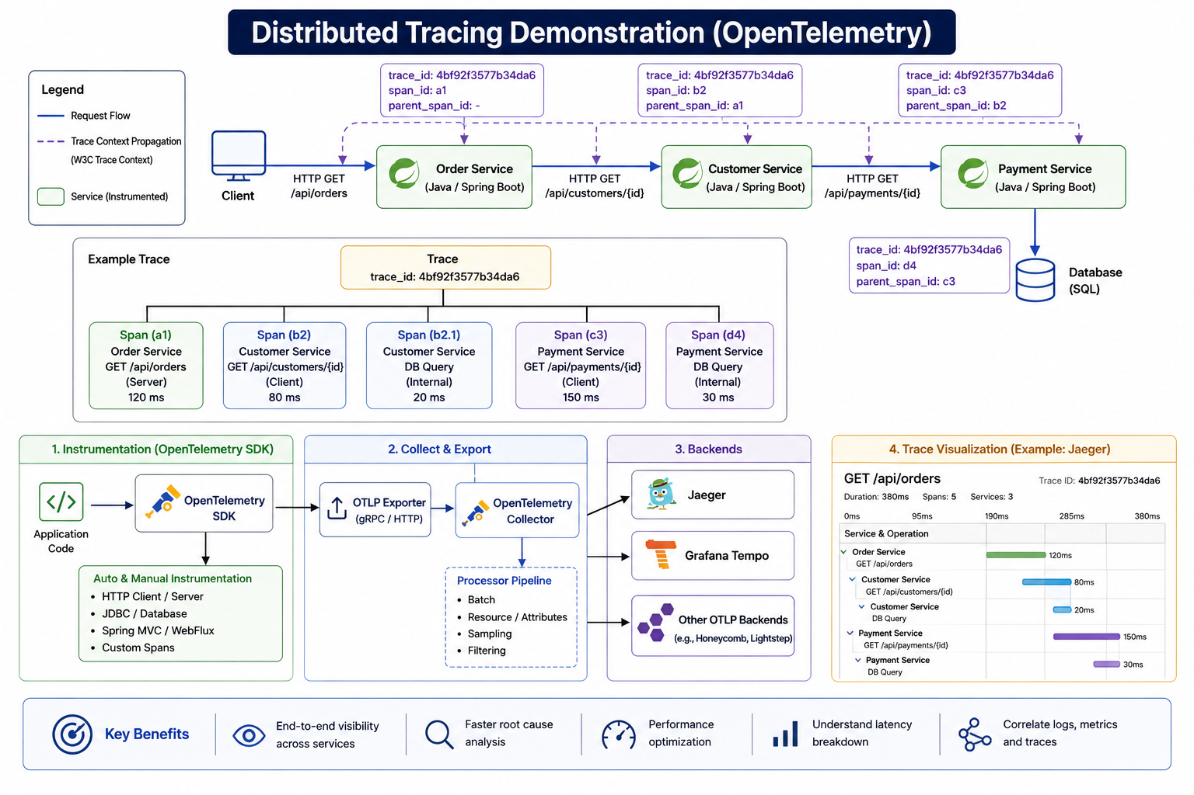
14
© 2026 by Innovation In Software Corporation
Notes:
KEY TALKING POINTS
------------------
- Request flow and trace context propagation
The trace id is created once and reused by every hop, while each hop creates its own span and records its parent.
That parent link is what lets a backend rebuild the tree.
Propagation uses the W3C traceparent header.
OpenTelemetry's Java instrumentation injects and extracts it automatically for common HTTP clients and servers.
If one service in the chain uses a client the instrumentation does not cover, the trace splits in two.
That broken-trace symptom is worth naming for the room.
- Example Trace
Spans have kinds: server spans for incoming requests, client spans for outgoing calls, and internal spans for work such as a database query.
Durations show where time is spent.
Treat the numbers as illustrative and inconsistent.
The root span is shown shorter than its children, and the tree draws every span directly under the trace instead of following the parent chain in the top boxes.
The real lesson is the shape: nested spans reveal whether latency sits in your code, a downstream call, or the database.
- Instrumentation, Collect and Export, and Backends
Instrumentation can be automatic, through the OpenTelemetry Java agent or Spring Boot's Micrometer Tracing integration, or manual, through custom spans around business steps such as risk scoring.
OTLP over gRPC or HTTP sends spans to a Collector.
There, batching reduces overhead, sampling controls volume and cost, and attribute processors can strip sensitive data before export.
Backends are swappable because OTLP is vendor-neutral: Jaeger, Grafana Tempo, and commercial tools all accept it.
- Trace Visualization and Key Benefits
The waterfall view is where tracing pays off.
Each bar is a span on a shared time axis, so a long bar under a short parent is immediately visible.
The benefits strip ties back to Module 9: end-to-end visibility, faster root-cause analysis, latency breakdown, and correlation with logs and metrics.
In Lab 4 the correlation id plays the same role at a smaller scale.
It is a single id you can search across both containers' logs.
REAL-WORLD EXAMPLES
-------------------
- Wire transfer latency: a transfer request touches authentication, limits checking, sanctions screening, and the core ledger.
A trace shows the extra seconds are all in the sanctions-screening call during a batch update, so the team goes to the screening provider instead of tuning its own code.
- Uber publicly described building its own distributed tracing system, Jaeger, to understand request paths across its large microservice estate, and later contributed it to the Cloud Native Computing Foundation.
It is now one of the common OpenTelemetry backends shown on this slide.
USE-CASE SCENARIO
-----------------
Imagine the capstone fully instrumented.
A client posts a transaction with a correlation id.
Transaction Service creates a server span, then a client span for its call to Account Service.
Account Service adds its own server span and a JDBC span against account-db.
Transaction Service then adds a producer span for the Kafka publish to transactions.submitted.
When users report slow submissions, the waterfall shows the account lookup is fast and the Kafka send is slow.
That points the team at broker health, which is exactly what the Module 9 messaging slide asks you to watch.

Slide 16
CORRELATING LOGS, METRICS, AND TRACES · HEALTH CHECKS AND READINESS SIGNALS
📌
HOW CORRELATION WORKS
📌
THREE TYPES OF HEALTH SIGNALS
✅
SPRING BOOT ACTUATOR EXAMPLE
1. A request is made and assigned a unique trace-id
2. The trace-id is propagated across all services
3. Services emit logs, metrics, and spans with the same context
4. Visualization tools (Grafana) link the data using correlation fields and time
• Liveness probe: "Is my app running?" -- failure triggers a container restart
• Readiness probe: "Is my app ready to serve traffic?" -- failure removes the pod from Service endpoints
• Startup probe: "Is my app started up?" -- protects slow-starting apps during initialization
• GET /actuator/health/liveness and /actuator/health/readiness both return {"status": "UP"}
KEY TAKEAWAY Jumping from a metrics spike to the exact trace to the precise error log -- all linked by one trace-id -- is what turns signals into a root cause. • Liveness, readiness, and startup probes each answer a different question, and together they keep unhealthy pods off the traffic path.
15
© 2026 by Innovation In Software Corporation
Notes:
TOPIC 1 OF 2: Correlating Logs, Metrics, and Traces
------------------------------------------
KEY TALKING POINTS
------------------
- HOW CORRELATION WORKS
The id is created once, at the edge or in the first service, and must never be regenerated downstream.
It moves between services in HTTP headers (the W3C traceparent header when OpenTelemetry is in use), and it must also ride on Kafka message headers or the trail breaks at the broker.
Logs carry the id through the logging MDC and spans carry it natively.
Metrics link back through exemplars or matching labels and time windows.
Grafana then lets an engineer click from a latency panel to a trace, and from a span to its log lines.
Our capstone uses a simpler handle: the X-Correlation-Id header shows up in every log line as correlationId=.
REAL-WORLD EXAMPLES
-------------------
- Card authorisation: a card is declined at a grocery checkout.
The support engineer searches the authorisation reference in the log platform and opens the matching trace.
It shows the time went into waiting for the fraud-scoring call, not into the card network.
Without a shared id, three teams would each be checking their own dashboards.
- Partner APIs: banks commonly require every inbound API call to carry a request or correlation id and echo it back in the response header.
When a branch system or partner reports a failed payment, they quote that id, and operations can pull every related log line across services with one search.
USE-CASE SCENARIO
-----------------
A teller reports that a transfer created mid-morning still shows RECEIVED and never moves on.
The on-call engineer sees a small rise in HTTP 5xx on Transaction Service's request metrics around that minute.
The API response returned an X-Correlation-Id, so she searches both services' logs for that correlationId= value.
Account Service shows the account lookup succeeded, and Transaction Service shows the Kafka publish timing out.
One id turned three unrelated-looking symptoms into a single timeline and pointed at the broker connection instead of the account lookup.
TOPIC 2 OF 2: Health Checks and Readiness Signals
------------------------------------------
KEY TALKING POINTS
------------------
- THREE TYPES OF HEALTH SIGNALS
Liveness asks whether the process is stuck beyond recovery.
If it keeps failing, the kubelet kills and restarts the container.
Readiness asks whether this instance should take requests right now.
A failure only removes the pod from the Service endpoints, so nothing restarts and traffic goes to healthy replicas.
The startup probe runs first and holds liveness and readiness off until the app has booted, so a slow Spring context or Flyway migration is not mistaken for a hang.
In the Lab 4 manifests the startup probe allows 30 failures at 5-second intervals, about two and a half minutes.
- SPRING BOOT ACTUATOR EXAMPLE
Spring Boot exposes these as health groups once management.endpoint.health.probes.enabled is true, which Lab 3 already set.
The liveness group reports the application's LivenessState.
The readiness group reports ReadinessState, which only switches to accepting traffic after the context has fully started.
When healthy, both return HTTP 200 with status UP.
When not, they return 503, which is what an HTTP probe reads.
In Lab 4 these endpoints stay public so the kubelet and operators can call them without a JWT, while /actuator/metrics still needs a token.
REAL-WORLD EXAMPLES
-------------------
- Mobile banking on payday morning: a new pod joins during a scale-up while its connection pool is still warming.
Readiness keeps that pod out of rotation until it can answer quickly, so customers checking balances do not hit timeouts from an instance that is only half started.
- A statement-generation service deadlocks its worker threads overnight.
The process is still running, so a basic process monitor stays green, but the liveness endpoint stops answering.
The platform restarts the container automatically instead of waiting for the morning shift to notice missing statements.
USE-CASE SCENARIO
-----------------
In Lab 4, Account Service starts slowly on OpenShift because Flyway runs its migrations against account-db.
With only a liveness probe and a short delay, the kubelet would kill the container mid-boot again and again.
That produces a CrashLoopBackOff that looks like a code bug.
The startup probe in 10-account.yaml gives it about 150 seconds instead.
Once the app is up, readiness returns 200 and the Service starts routing to the pod.
Only then does the Step 5 readiness call through the Account Route succeed.

Slide 17
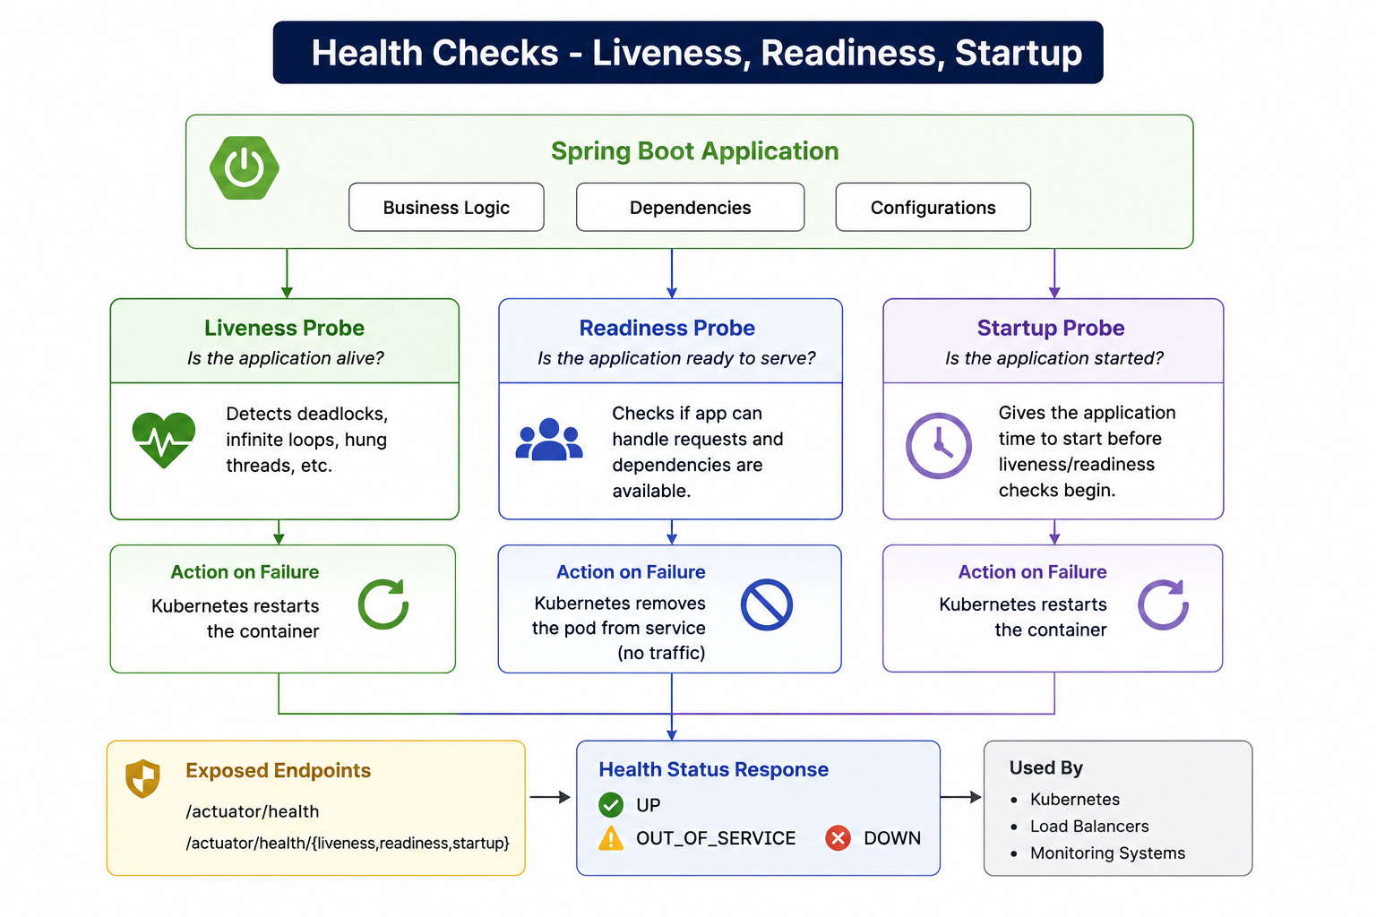
16
© 2026 by Innovation In Software Corporation
Notes:
KEY TALKING POINTS
------------------
- Spring Boot Application banner
The three boxes are a reminder that a healthy JVM is not the same as a healthy service.
Account Service can be running while its datasource is unreachable or a bad configuration value breaks every request.
Health indicators turn those internal conditions into a simple status the platform can read.
Ask learners which of the three boxes each probe should care about.
Liveness should mostly ignore external dependencies.
Readiness can reasonably reflect them.
- Liveness, Readiness, and Startup columns
Each column pairs a question with a consequence, and that pairing is the key point.
Liveness failure means restart.
Readiness failure means remove from traffic without a restart.
Startup failure also means restart, but only after its generous threshold runs out, which protects slow boots.
In the Lab 4 manifests, liveness runs every 15 seconds, readiness every 10 seconds, and startup every 5 seconds for up to 30 attempts.
Getting the consequence wrong is how teams end up with restart storms or pods that silently receive traffic while broken.
- Exposed Endpoints and Health Status Response
The endpoint panel shows /actuator/health plus a combined liveness, readiness, and startup path.
The first two exist once probes are enabled.
Spring Boot does not ship a startup health group, so tell the room the Lab 4 startupProbe reuses /actuator/health/liveness.
The status box lists UP, OUT_OF_SERVICE, and DOWN.
By default the last two map to HTTP 503, and that status code, not the JSON body, is what an HTTP probe actually evaluates.
- Used By panel
The diagram says Kubernetes.
On Day 4 that means Red Hat OpenShift, which is built on Kubernetes: the kubelet on each node runs the probes, and readiness decides Service endpoint membership.
Load balancers and monitoring systems can poll the same endpoints, which is one reason Lab 4 keeps health public while metrics require a JWT.
Dashboards that chart readiness flapping are often the first sign of a struggling dependency.
REAL-WORLD EXAMPLES
-------------------
- Payment gateway rollout: during a rolling deployment of a card-payment API, new pods only receive traffic once readiness passes.
If a new version cannot reach its database because of a wrong URL, the rollout stalls with old pods still serving, instead of cutting customers over to a broken release.
- Batch reconciliation service: a nightly reconciliation job hangs on a lock and stops making progress.
Its liveness check reports the stuck worker, the platform restarts the container, and the job resumes from its last checkpoint without anyone being paged at 3 a.m.
USE-CASE SCENARIO
-----------------
Picture the capstone on the ARO cluster.
Transaction Service is Ready, but account-db restarts during maintenance.
Account Service readiness would fail if the team had added the database to the readiness group, and the pod would drop out of Service endpoints.
Transaction Service's calls then fail fast, and Lab 3's rule still holds: return 503 rather than pretend the account is ACTIVE.
Liveness stays green, so nothing restarts pointlessly.
When the database returns, readiness recovers and traffic resumes without a human doing anything.

Slide 18
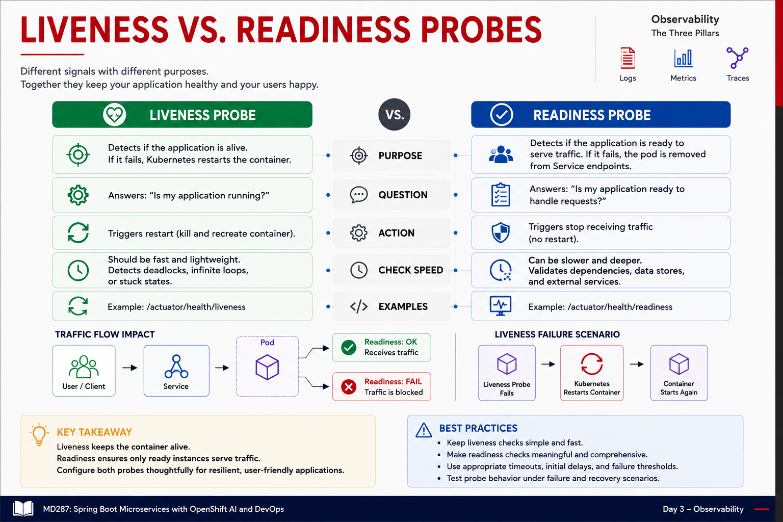
17
© 2026 by Innovation In Software Corporation
Notes:
KEY TALKING POINTS
------------------
- LIVENESS VS. READINESS
Read the table as a decision guide.
Liveness asks a narrow question: is this process able to make progress at all?
It should be cheap and independent of downstream systems, because its failure causes a restart.
Readiness asks whether sending traffic here right now is a good idea.
It may consider warm-up, connection pools, or a dependency, because failing only moves traffic elsewhere.
Both example paths come from Spring Boot Actuator.
They are exactly the paths the Lab 4 Deployments probe on ports 8081 and 8082.
- Traffic flow impact
Readiness works through the Service.
The Service only forwards to pods listed as ready endpoints, so a pod failing readiness still runs, keeps its logs, and can be inspected, but gets no new requests.
That is why readiness is the right tool during warm-up or a brief dependency blip.
If every replica fails readiness at once, the Service has no endpoints and callers get errors, so readiness depth must be chosen with care.
- Liveness failure scenario
The three boxes show the restart loop: probe fails, container is killed, container starts again.
If the root cause is outside the container, such as a database outage or a bad ConfigMap value, restarting does not help.
The pod climbs its restart count into CrashLoopBackOff with growing delays.
That is the classic symptom of putting dependency checks into liveness, or of having no startup probe for a slow-starting Spring Boot app.
- Best practices
Keep liveness simple and fast, and make readiness meaningful.
Tune timeouts, delays, and failure thresholds instead of accepting defaults blindly.
Test what actually happens when a dependency fails and recovers.
The Lab 4 manifests show one reasonable baseline: a startup probe with a high threshold, liveness every 15 seconds, and readiness every 10 seconds.
Encourage learners to change one value on the cluster and watch oc get pods to see the effect.
REAL-WORLD EXAMPLES
-------------------
- Online banking login service: after a release, the identity provider is briefly slow.
Readiness on a few pods dips and traffic shifts to healthy replicas.
Had the team wired the identity-provider check into liveness, every pod would have restarted together and turned a slow login into a full outage.
- Loan-origination API: a pod hits a thread-pool deadlock that never clears.
Readiness alone would just keep it out of rotation indefinitely and waste capacity, while liveness catches the stuck process and restarts it so the replica count is genuinely restored.
USE-CASE SCENARIO
-----------------
On the classroom cluster, a participant tests a hypothesis by pointing Transaction Service's liveness probe at an endpoint that depends on Kafka.
The instructor briefly scales the shared Kafka down.
Within a minute every Transaction pod restarts, and new transactions fail while pods cycle.
Switching back to the Lab 4 manifest, liveness on /actuator/health/liveness and readiness on /actuator/health/readiness, the same Kafka blip leaves pods running.
Transactions sit at RECEIVED instead of SUBMITTED, and they recover once the broker returns.

Slide 19
ALERTING PRINCIPLES
An alert tied to user impact or SLO burn, with enough context to act on immediately, is the bar every alerting rule should be held to.
📌
SIX CORE ALERTING PRINCIPLES
✅
ALERT FLOW
1. Be specific: say what broke and where, so nobody has to guess which service is involved
2. Be actionable: every alert points at something a human can actually do right now
3. Be timely: fire early enough to act, late enough to avoid noise from transient blips
4. Be relevant: route to the team that owns the service, not to a channel everyone ignores
5. Be noise-free: an alert that is routinely dismissed trains people to ignore the real one
6. Be reviewed: prune and tune alerts regularly, because systems and thresholds drift
• Metrics/Logs/Traces -> Detection -> Alert Triggered -> Notification -> Investigation & Action -> Review & Improve
KEY TAKEAWAY An alert tied to user impact or SLO burn, with enough context to act on immediately, is the bar every alerting rule should be held to.
18
© 2026 by Innovation In Software Corporation
Notes:
KEY TALKING POINTS
------------------
- SIX CORE ALERTING PRINCIPLES
Specific means the alert names the service, environment, and symptom, such as Transaction Service in the md287 project returning 5xx above its threshold, not a vague 'app unhealthy'.
Actionable means there is a runbook step a human can take now.
Timely means using a sensible evaluation window so a two-second blip does not page anyone, yet a sustained problem is not missed.
Relevant means routing to the owning team.
Noise-free protects credibility, because an alert people learn to dismiss hides the real one.
Reviewed means pruning alerts as services and thresholds change.
- ALERT FLOW
Read the flow as a loop, not a line.
Signals from logs, metrics, and traces feed a detection rule, often a query over time-series data.
When the rule's condition holds for its window, the alert fires and a notification reaches a pager, chat channel, or ticket queue.
Investigation and action is where correlation ids and dashboards earn their keep.
The final Review and Improve step feeds lessons back into rules and runbooks, so every incident leaves the alerting better tuned than before.
REAL-WORLD EXAMPLES
-------------------
- Payments operations: instead of paging on CPU over a fixed percentage on every node, a payments team pages when the rate of failed payment submissions rises above normal for several minutes.
CPU stays visible on a dashboard for diagnosis, but only customer-facing failure wakes someone up.
- Enterprise on-call practice: many teams, following the approach described in Google's Site Reliability Engineering books, alert on error-budget burn rate against a service level objective.
A fast burn pages immediately, while a slow burn opens a ticket for working hours.
USE-CASE SCENARIO
-----------------
The capstone team drafts its first alert for the risk platform.
Version one fires whenever any Actuator health check on any pod is not UP.
It pages on every rolling deployment, because new pods are briefly not ready.
Version two is specific and actionable: Transaction Service returning 503 on POST /api/v1/transactions for more than five minutes, routed to the transaction team.
It links a dashboard and a runbook saying to check Account Service readiness first, since Lab 3 returns 503 when Account Service is unavailable.

Slide 20
REDUCING ALERT FATIGUE
Focusing on outcomes, deduplicating, and suppressing intelligently turn a wall of noisy alerts into a short list of actionable insights.
📌
SIX STRATEGIES TO REDUCE FATIGUE
⚠️
COMMON CAUSES OF ALERT FATIGUE
1. Focus on outcomes: alert on user-visible symptoms rather than on every internal metric
2. Route and escalate: send to the owning team first, with a defined path if nobody responds
3. Tune and test: adjust thresholds against real incidents, and verify the alerts actually fire
4. Deduplicate: group related alerts so one failure produces one page, not fifty
5. Suppress intelligently: silence downstream alerts during a known upstream outage or deployment
6. Continuously improve: feed every noisy page back into the alert definitions
• Too many alerts, alerting on symptoms instead of root causes, poorly tuned thresholds
• Duplicate/overlapping alerts and alerts not routed to the right team
KEY TAKEAWAY Focusing on outcomes, deduplicating, and suppressing intelligently turn a wall of noisy alerts into a short list of actionable insights.
19
© 2026 by Innovation In Software Corporation
Notes:
KEY TALKING POINTS
------------------
- SIX STRATEGIES TO REDUCE FATIGUE
Focus on outcomes: page on what customers feel, such as failed or slow transactions, and keep internal metrics for diagnosis.
Route and escalate: the owning team gets it first, with a defined backup if nobody acknowledges.
Tune and test: set thresholds from real incident history and confirm the alert actually fires in a test.
Deduplicate: one broken dependency should raise one grouped page, not fifty.
Suppress intelligently: silence downstream noise during a known upstream outage or planned change window.
Continuously improve: every page that needed no action is a defect to fix.
- COMMON CAUSES OF ALERT FATIGUE
Too many alerts and badly tuned thresholds are the usual culprits, often inherited from default monitoring templates.
Duplicates appear when each layer, such as pod, service, and route, alerts on the same failure.
Poor routing sends everything to a shared channel nobody owns.
One bullet needs clarifying: it lists alerting on symptoms as a cause, which contradicts strategy one.
The accepted practice is to page on user-visible symptoms and use cause-level signals as context for diagnosis, not as separate pages.
REAL-WORLD EXAMPLES
-------------------
- Planned maintenance: a bank's core database has a scheduled patch window.
Operations sets a silence for dependent services' connection-error alerts during that window.
Only the customer-facing availability alert stays active, so on-call staff are not flooded with hundreds of expected downstream errors.
- Mobile app outage: an upstream identity provider fails, and login, balance, and transfer services all start erroring.
Grouped alerting rolls these into one incident pointing at the shared dependency, instead of three teams being paged separately and chasing the same root cause.
USE-CASE SCENARIO
-----------------
During a practice week, the capstone team's alert channel fills with readiness failures every time someone runs a rolling deploy or oc rollout undo in Lab 4 Step 7.
By Wednesday people have muted the channel.
The team retires the per-pod readiness alert and replaces it with an alert on sustained 503 responses at the Transaction Service API.
They also suppress alerts during announced deploy windows.
The next genuine problem, Account Service unable to reach account-db, pages once, with a clear owner and a linked runbook.

Slide 21
OBSERVABILITY FOR MESSAGING SYSTEMS · OBSERVABILITY MATURITY MODEL
📌
WHAT TO OBSERVE
✅
COMMON ALERTS
📌
THE FIVE MATURITY LEVELS
• Health (broker availability, connectors), throughput (in/out rates)
• Backlog (queue depth, consumer lag), errors (DLQ rate, retries), latency (end-to-end)
• Consumer lag exceeds threshold; queue depth or oldest message age too high
• Error rate or DLQ messages detected; broker down or partition unavailable
• Level 1 Initial: basic monitoring, manual troubleshooting
• Level 2 Developing: centralized logs, dashboards, defined alerting
• Level 3 Defined: distributed tracing, SLOs, error budgets, capacity visibility
• Level 4 Advanced: anomaly detection, predictive alerts, service dependency maps
• Level 5 Optimized: autonomous remediation, observability as a product
KEY TAKEAWAY Consumer lag and dead-letter-queue depth are the two messaging-specific signals that traditional API monitoring alone would never catch. • Level 1's manual troubleshooting evolves through correlation and prediction all the way to Level 5's autonomous remediation and self-service analytics.
20
© 2026 by Innovation In Software Corporation
Notes:
TOPIC 1 OF 2: Observability for Messaging Systems
------------------------------------------
KEY TALKING POINTS
------------------
- WHAT TO OBSERVE
Health covers whether brokers, and any connectors, are up and partitions have leaders.
Throughput is messages in and out per second.
If in keeps exceeding out, a backlog is forming.
Backlog in Kafka terms is consumer lag: the gap between the latest offset on a partition and the offset a consumer group has committed.
Traditional queues call this queue depth.
Errors include retries and messages sent to a dead-letter topic.
End-to-end latency measures time from produce to successful processing, which no single service's HTTP timer can show.
- COMMON ALERTS
Consumer lag above a threshold for a sustained period is the core asynchronous alert.
It means work is arriving faster than it is processed, or processing has stopped.
Oldest message age is often more meaningful than raw counts, because it measures how stale the oldest work is.
Any message landing on a dead-letter topic deserves attention, because each one represents a business event that was not processed.
Broker down or partition unavailable are platform alerts, usually owned by the team running Red Hat AMQ Streams rather than by application teams.
REAL-WORLD EXAMPLES
-------------------
- Payment notifications: a consumer that sends payment-confirmation texts slows down after a dependency change.
Its HTTP endpoints look healthy, but consumer lag grows for an hour.
Customers get confirmations long after paying, and only a lag alert catches the problem before complaint calls do.
- Card dispute events: a malformed dispute event from a new upstream version repeatedly fails deserialisation and is routed to the dead-letter topic.
An alert on any dead-letter message tells the team the same day, instead of discovering a pile of unprocessed disputes at month-end reconciliation.
USE-CASE SCENARIO
-----------------
In the capstone, Transaction Service saves a transaction as RECEIVED and publishes it to the Kafka topic transactions.submitted.
Lab 4's Compose file also creates transactions.submitted.DLT as the dead-letter topic.
If Kafka is unhealthy, transactions stay RECEIVED instead of moving to SUBMITTED, which is one of the Lab 4 troubleshooting rows.
A useful set of messaging alerts for this platform would be: lag on any consumer group reading transactions.submitted, any new message on the DLT, and transactions staying RECEIVED beyond an agreed age.
TOPIC 2 OF 2: Observability Maturity Model
------------------------------------------
KEY TALKING POINTS
------------------
- THE FIVE MATURITY LEVELS
Level 1 is logging into servers and reading files after a customer complains.
Level 2 centralises logs, adds dashboards, and defines alerts, so problems are seen in one place.
Level 3 adds distributed tracing, service level objectives with error budgets, and capacity visibility, so teams can measure reliability against agreed targets.
Level 4 uses anomaly detection, predictive alerts, and service dependency maps to spot trouble before thresholds are crossed.
Level 5 automates common remediation and runs observability as an internal product with owners, standards, and self-service.
Most organisations sit at different levels for different systems.
REAL-WORLD EXAMPLES
-------------------
- Retail bank modernisation: a bank migrating from mainframe-adjacent batch systems to microservices often starts at Level 2 for new services, with central logs and dashboards, while legacy platforms remain at Level 1.
It then introduces SLOs for its digital channels first, because those have the clearest customer impact.
- Automated remediation at Level 5: a platform team encodes a well-understood runbook, such as restarting a stuck consumer when lag grows and its liveness endpoint fails.
The automation runs it and records the action, while humans only review the incident afterwards unless the automation fails.
USE-CASE SCENARIO
-----------------
At the end of Lab 4, ask the class to place the capstone on the model.
It has central-ish logs via docker logs and oc logs, correlation ids in every line, Actuator health probes that OpenShift acts on, and metrics behind a JWT.
That is solidly Level 2 with a foothold in Level 3.
Tracing is demonstrated but not deployed, and there are no SLOs yet.
The team's next step would be an SLO on transaction submission success, with an error budget, before anyone talks about AI-driven anomaly detection on Day 5.

Slide 22
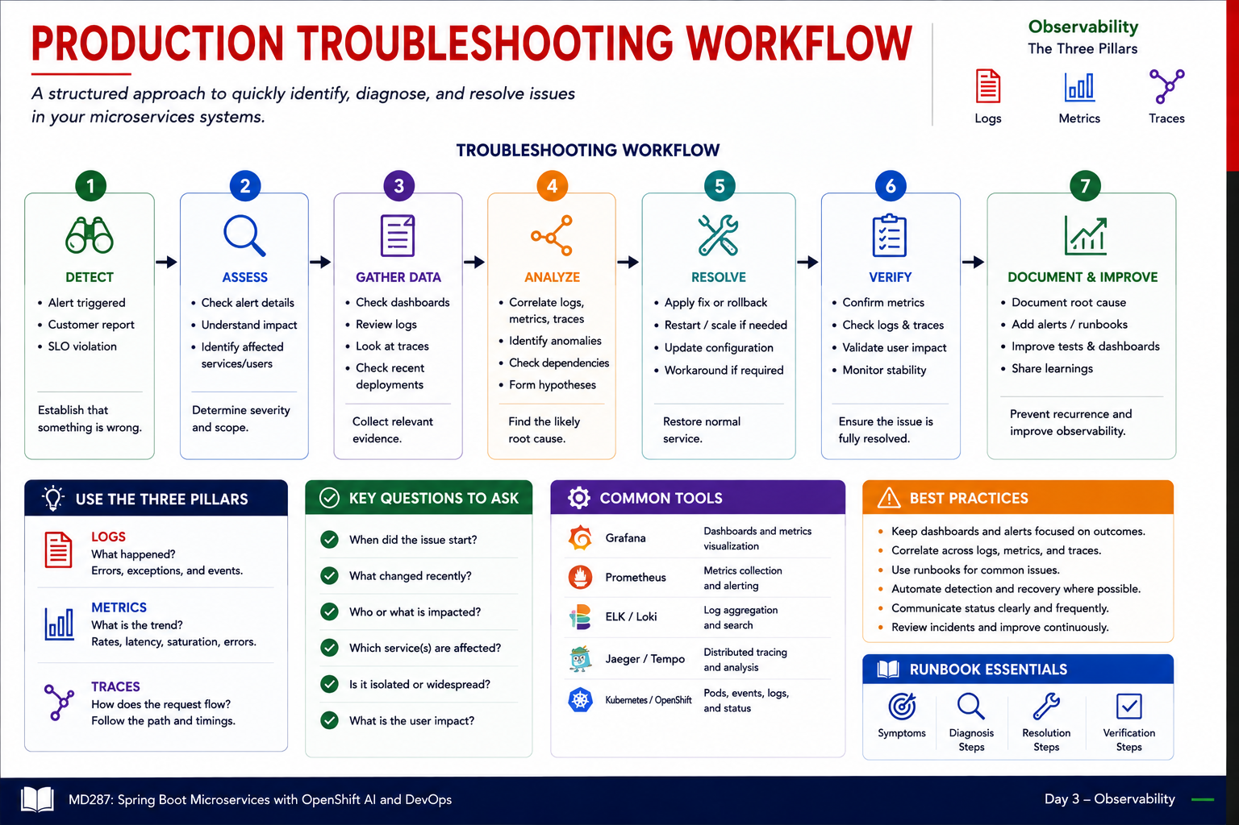
21
© 2026 by Innovation In Software Corporation
Notes:
KEY TALKING POINTS
------------------
- THE SEVEN-STEP WORKFLOW
Detect and Assess decide how loud the response should be.
A single failed request and a platform-wide outage need different escalation.
Gather Data should always include what changed, because recent deployments cause a large share of incidents.
Analyze means forming a hypothesis you can test from evidence, not acting on the most senior person's hunch.
Resolve favours the fastest safe restoration, often a rollback, over a clever fix under pressure.
Verify uses the same signals that detected the problem.
Document and Improve turns one incident into better alerts, runbooks, and tests.
- KEY QUESTIONS TO ASK
When did it start sets the time window for every query, and lets you line it up against deployment and change records.
What changed recently covers code, configuration, secrets, infrastructure, and upstream dependencies.
Who or what is impacted drives severity and communication.
Which services are affected, and whether the problem is isolated or widespread, separate a single bad pod from a shared dependency failure.
The diagram adds what the user impact is, which should shape both priority and customer messaging.
- Common tools and runbook essentials
The tools panel maps each pillar to typical products.
Grafana and Prometheus for metrics, ELK or Loki for logs, Jaeger or Tempo for traces, and OpenShift for pod status, events, and container logs.
On Day 4 the tools you actually use are oc get pods, oc describe, oc logs, oc get events, and curl against Actuator.
A runbook turns this workflow into a checklist for a known failure: symptoms, diagnosis steps, resolution steps, and verification steps.
REAL-WORLD EXAMPLES
-------------------
- Friday release regression: a bank's bill-pay service starts timing out shortly after a Friday afternoon deployment.
Asking what changed points straight to the release, and the team rolls back first, restoring service in minutes.
Root-cause analysis of the new version happens on Monday, without customers waiting.
- Shared dependency failure: several unrelated digital banking services report errors at the same moment.
Asking whether it is isolated or widespread quickly shows a common certificate expiry on an internal gateway.
That redirects three teams from debugging their own code to a single fix.
USE-CASE SCENARIO
-----------------
During Lab 4 Step 5, a participant's Account Service pod never becomes Ready.
Detect: oc get pods shows 0/1.
Assess: only their project is affected.
Gather data: oc describe pod shows CreateContainerConfigError, mentioning runAsNonRoot and a non-numeric user.
Analyze: OpenShift cannot prove the named user md287 is non-root.
Resolve: keep runAsNonRoot true and set runAsUser 100, as in the solution manifest.
Verify: the pod is Ready and the Route readiness call returns 200.
Document: add the row to the team runbook, just as the Lab 4 troubleshooting table does.

Slide 23
EXERCISE 4.1 — ADD HEALTH PROBES AND CORRELATION LOGGING
Module 9 checkpoint A — Operability basics.
🎯
OBJECTIVE
📝
DO THIS
✅
EXPECTED RESULT
• Operability basics
• 10 min · code warmup checkpoint
• Worksheet: curriculum/day-04/exercises/exercise-4.1-probes-correlation.md
1. Liveness vs readiness vs startup — which Actuator paths, and why startup exists
2. X-Correlation-Id on the request must appear as correlationId= in logs
3. Health stays public; /actuator/metrics still needs a JWT
4. Tracing (OpenTelemetry) is a demonstration — you do not stand up Jaeger
• You can tell liveness from readiness and find a correlation id in a log line.
• Lab 4 verifies liveness/readiness and correlationId= in logs, then the same probes on OpenShift.
KEY TAKEAWAY You can tell liveness from readiness and find a correlation id in a log line.
22
© 2026 by Innovation In Software Corporation
Notes:
KEY TALKING POINTS
------------------
- OBJECTIVE
The goal is operability basics, meaning whether an operator and the platform can tell if a service is healthy and follow one request through it.
It is a ten-minute warm-up, not a build task.
Participants talk through the Lab 3 solution and the Lab 4 manifests rather than writing new Java.
The worksheet is exercise-4.1-probes-correlation.md.
It is the official outline checkpoint, so do not substitute the older TEKsystems exercises that mention Customer Service, Redis, or Jenkins.
- DO THIS
Good answers: liveness is /actuator/health/liveness and readiness is /actuator/health/readiness.
The startup probe exists so a slow Spring Boot boot with Flyway migrations is not killed by liveness.
In the Lab 4 manifests it reuses the liveness path with 30 attempts every 5 seconds.
For correlation, the Lab 3 CorrelationIdFilter reads X-Correlation-Id, or creates a UUID, and puts it into the MDC.
The logback pattern then prints correlationId= on every line.
Health is public so probes need no token, while /actuator/metrics needs a JWT.
Tracing is shown, not installed.
- EXPECTED RESULT
Each participant should be able to state the difference between liveness and readiness in one sentence each, including the failure action.
They should also point at a correlationId= value in a sample log line.
The success criteria ask for a sketch or filled worksheet the instructor can review, with scope limited to Account, Transaction, and Risk Assessment.
Lab 4 Step 4 then proves the same things for real: probes return 200 without a JWT, metrics work with a teller token, and logs show correlationId=lab4-demo.
Step 5 repeats the probes on OpenShift.
REAL-WORLD EXAMPLES
-------------------
- Production readiness reviews: many banks run a checklist before a service goes live.
Typical items include health endpoints wired to the platform, a request or correlation id on every log line, and no sensitive headers logged.
This checkpoint is a small version of that same review.
- Operations handover: when an application team hands a service to a production support group, the first questions are how do I know it is healthy and how do I find a customer's request.
Probes and correlation ids answer both without anyone reading source code.
USE-CASE SCENARIO
-----------------
Run it in pairs or threes for ten minutes.
Give each group a printout or screen of 10-account.yaml, the Lab 3 logback-spring.xml, and a sample log line.
One person explains the three probes, another finds where correlationId comes from, and the third explains why metrics need a token.
Circulate and listen for groups who say liveness should check the database, and redirect them.
Debrief for about five minutes with three questions.
What restarts on liveness failure?
What does correlationId=none mean in a startup log line?
Why is health public but metrics protected?

